Slide 1

Business Analytics: The Science of Data-Driven Decision Making
Based on the work of Simchi-Levi, David (2014) and Mišić, Velibor V., and Georgia Perakis (2020)

Slide 2
Data-Driven Decision Making
Increased computing power and the explosion of data are changing the way organizations capture data, analyze information, and make decisions.
These changes provide opportunities for us to analyze extensive data to identify new models that drive decisions and actions.

Slide 3
Data-Driven Decision Making
But connecting the realms of data, models, and decisions will require us to move out of our comfort zone and address intellectual challenges that demand bringing together statistics, computational science, and operations research (OR) techniques.
At its heart, it is about letting the data tell a story that helps identify new opportunities for investigate, including new models that we have not analyzed before.

Slide 4
Online Retailer Example
An online retailer offers new products via online 48-hour sales events.
Since every event involves products from different designers and with different styles, the online retailer has very little knowledge of customer demand as a function of price.
As a result, the retailer applies a single price during a typical 48-hour event by surveying prices for similar products offered by other retailers.

Slide 5
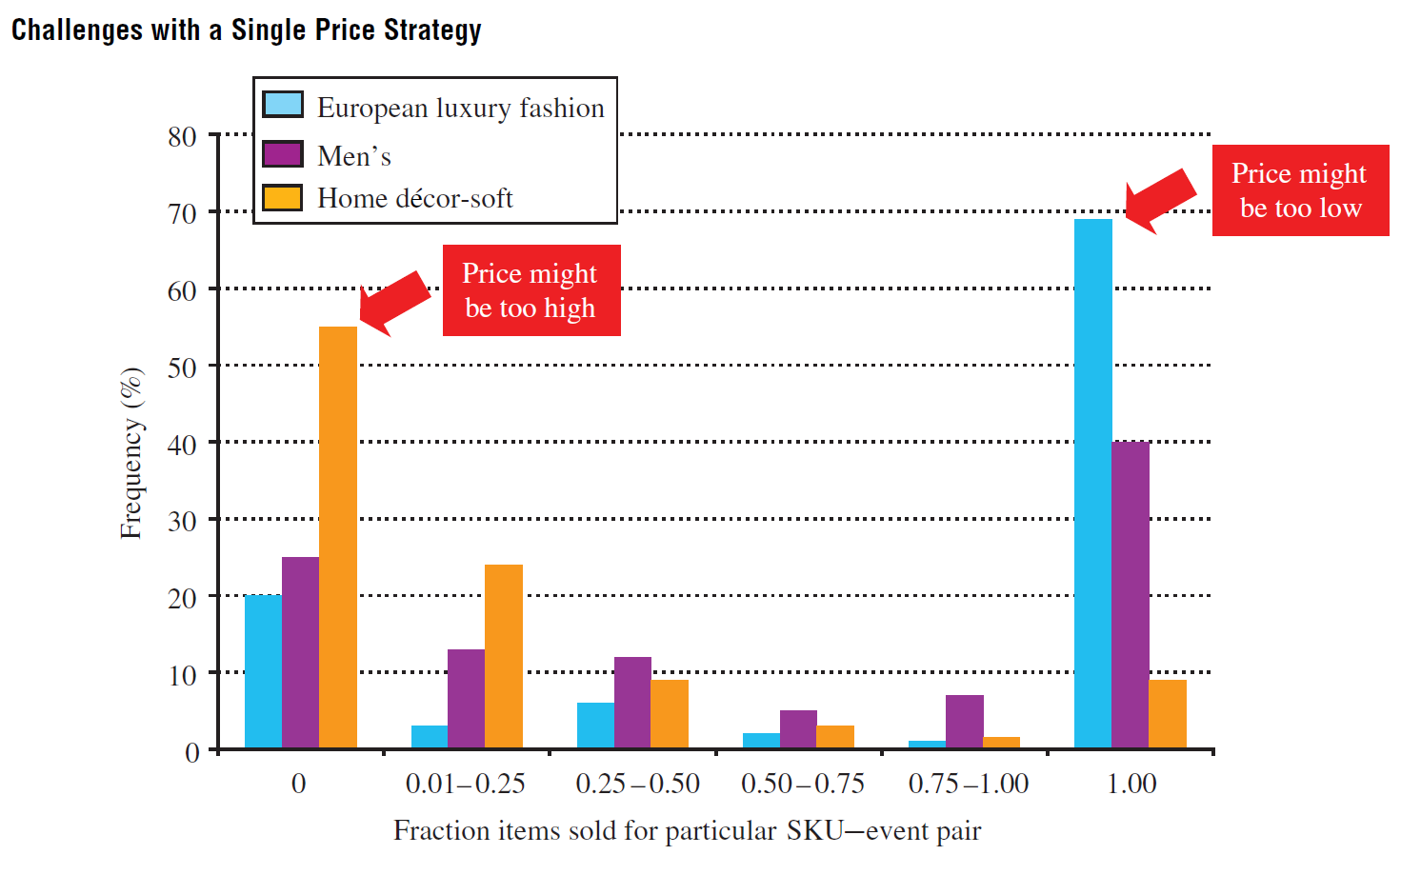
Online Retailer Example
The data provide an insight into the effectiveness of such a policy

Slide 6
Online Retailer Example
The question, of course, is whether the retailer has any data that may help improve the retailer pricing policy.
worked directly with the retailer to obtain and understand point of sales data, product information, and customer behavior
used all of these data along with machine learning techniques to improve demand forecast accuracy.
To translate a demand forecast into a pricing policy, developed new theory around assortment price optimization and created and implemented a pricing recommendation tool that has shown significant margin improvement

Slide 7
Online Retailer Example
The access to detailed data allowed the research team to further explore and identify additional business improvement opportunities and research ideas.
For example, they identified trends in the data that suggest that there exists an optimal range of the number of items for the retailer to include in an assortment.
Displaying too few items or too many items seems to have a negative impact on sales per item.

Slide 8
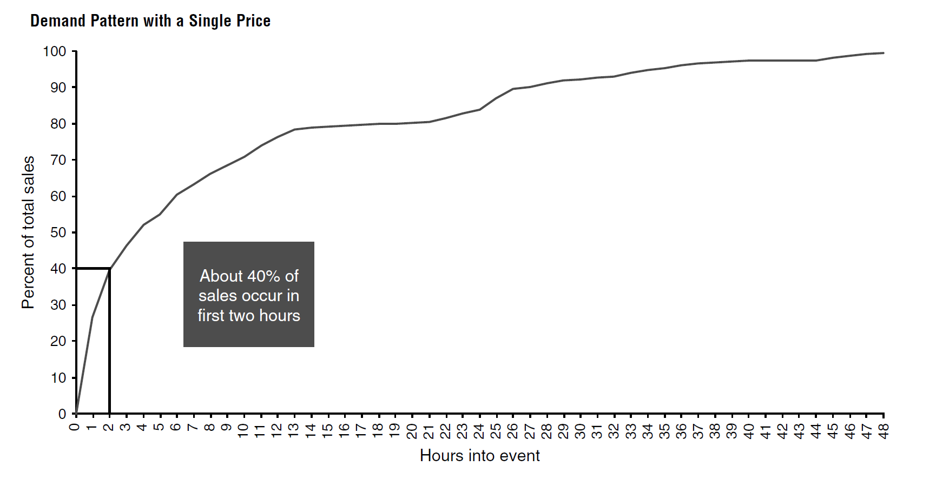
Online Retailer Example
The first few minutes of an event offer an insight into the customer demand function by observing these initial sales.

Slide 9
Online Retailer Example
This suggests that once an event starts, the retailer faces an exploration–exploitation trade-off between learning to gather more information about the demand function versus optimizing price to maximize revenue.
To help in the learning process, the research team use historical data to estimate a set of benchmark demand functions;
They developed a learning and optimization method under an important business constraint that the retailer identified: apply only a few different prices during the learning period.

Slide 10
Let the Data Drive the Model
For the online retailer example, the goal was to improve revenue, but it was not clear how to achieve that objective.
It was the data that suggested that the retailer had an opportunity to learn about consumer behavior in the first few minutes of an event and then optimize pricing decisions. This observation led to the development of a learning and optimization model.
Equally important, it was the data that suggested the need to carefully choose the number of items in an assortment and hence called for a model for assortment optimization.

Slide 11
Let the Data Drive the Model
Data-driven models are our opportunity to be more creative and play an important role in the development of what some call “business analytics.”
In various domains—such as retail, healthcare, and many more—richer data are becoming available that are more voluminous and more granular than ever before.
At the same time, the increasing abundance of data has been accompanied by methodological advances in a number of fields.

Slide 12
Let the Data Drive the Model
The field of machine learning, which exists at the intersection of computer science and statistics, has created methods that allow one to obtain high-quality predictive models for high-dimensional data.
The field of optimization has similarly advanced. Numerous scientific innovations in optimization modeling, such as robust optimization (Bertsimas et al. 2011), inverse optimization (Ahuja and Orlin 2001), and improved integer-optimization formulation techniques (Vielma 2015), have extended both the scope of what optimization can be applied to and the scale at which it can be applied

Slide 13
Let the Data Drive the Model
These advances have led to the development of the burgeoning field of data analytics (or analytics for short). The field of analytics can most concisely be described as using data to create models leading to decisions that create value.
Please check the paper “Data Analytics in Operations Management: A Review” for more examples of data analytics.

Slide 14
Future Directions - Interpretability
An exciting future direction is in the development of interpretable models in OM.
In machine learning, an interpretable model is one in which a human being can easily see and understand how the model maps an observation into a prediction.

Slide 15
Future Directions - Interpretability
Interpretability is a major area of research in machine learning for two reasons:
First, interpretable models can provide insights into the prediction problem that black-box models, such as random forests and neural networks, cannot.
Second, and more important, machine-learning models often do not affect decisions directly but instead make predictions or recommendations to a human decision maker.
In many contexts (e.g., medicine), a decision maker is unlikely to accept a recommendation made by a machine learning model without the ability to understand how the recommendation was made.

Slide 16
Future Direction - “Small-Data” Methods
One challenge that is being recognized with the increasing availability of data is that these data are often small.
This paradoxical statement refers to the fact that, often, although the number of observations one might have access to is large, the number of parameters that one must estimate is also large.
For example, imagine an online retailer offering a very large selection of products in a particular category; the retailer might be interested in estimating the demand rate of each product but may only see a handful of purchases for each product in a year.

Slide 17
Future Directions -Causal Inference
Machine learning is usually concerned with predicting a dependent variable using a collection of independent variables.
In many OM applications, the decision enters into the machine learning model as an independent variable.
For such settings, a more relevant perspective to take is in understanding the causal impact of the decision on the dependent variable.

Slide 18
Future Direction - New Approaches to “Predict-Then-Optimize”
Many of the papers described earlier rely on the “predict-then-optimize” paradigm: first, build a predictive model using data, and then embed that model within the objective function of an optimization problem.
Machine learning models are typically estimated so as to lead to good out-of-sample predictions; however, such models may not necessarily lead to good out-of-sample decisions.
This highlights the potential opportunities for revisiting how machine-learning models are constructed for prescriptive applications in OM.

Slide 19
Reference
Simchi-Levi, David. "OM forum—OM research: From problem-driven to data-driven research." Manufacturing & Service Operations Management 16.1 (2014): 2-10.
Mišić, Velibor V., and Georgia Perakis. "Data analytics in operations management: A review." Manufacturing & Service Operations Management 22.1 (2020): 158-169.

